Slide 1

APBD – lecture 2
Basics of C# Language
Design patterns
SOLID

Slide 2
C# language
It was designed by Andres Hejlsberg in1999.
It was originally named Cool which stood for C-like Object-Oriented Language.
In Nov 2005, C# 2.0 was released with the addition of generics.
Later it got its name C# inspired by musical notation. This name was also used by Microsoft earlier in the year 1988 for an incompleted project.

Slide 3
C# features
It was derived from C++ and Java.
It is part of Microsoft Visual Studio
Simple
No pointers
No operators like “::” or “->”
Varying ranges of primitive types.
Memory management and garbage collection is automatic and does not need explicit code.

Slide 4
C# features
Modern
Built according to the current trend.
Powerful, scalable, robust.
Object-Oriented
Supports OOP concepts such as inheritance, encapsulation, polymorphism, interfaces, etc.
C# introduces structures enabling primitive types to become objects.
Type-Safe
It does not allow us to perform unsafe casts.
Reference types are initialized to null and value types are initialized to zero by the compiler automatically.
Arrays are bound checked and are zero-based indexed.

Slide 5
C# vs Java - similarities
Object-Oriented: Both languages are object-oriented and hence support concepts like encapsulation, polymorphism, inheritance, and more.
Dependence from C and C++: C and C++ are a superset to both Java and C#.
Intermediate Language Code Generation: Java compiler and C# compilers both generate an intermediate language code after compilation. C# compiler generates Microsoft Intermediate Language (MSIL), whereas Java compiler generates Java bytecode.
Advance Features: Both languages include advanced features like garbage collection.
Syntax: Both languages are syntactically similar.
Multiple Inheritance: Both languages support multiple class inheritance.

Slide 6
C# vs Java - differences
Runtime Environment: Java runs on JRE(Java Runtime Environment), whereas C# runs on CLR(Common Language Runtime).
Programming Paradigm: Java is a strictly object-oriented language whereas C# is object-oriented as well as functional, strongly typed, and component-oriented.
Operator Overloading: Java doesn't support operator overloading, whereas C# supports operator overloading for multiple operators.
Pointers: Java does not support pointers, whereas C# supports pointers only in unsafe mode.
Arrays: Java arrays are a specialization of Object, while C# arrays are a specialization of System.

Slide 7

Aliases
string is an alias in C# for System.String.
Int is an alias for System.Int32

Slide 8
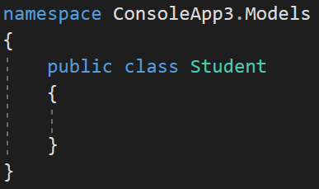
Namespaces
The namespace keyword is used to declare a scope that contains a set of related objects. You can use a namespace to organize code elements and to create globally unique types.

Slide 9

Using class from diff namespace

Slide 10
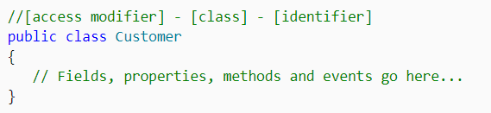
Classes
A type that is defined as a class is a reference type.

Slide 11

Classes
Creating an object using the default constructor.

Slide 12
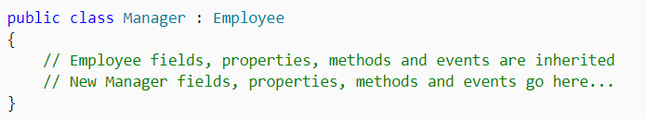
Class inheritance

Slide 13
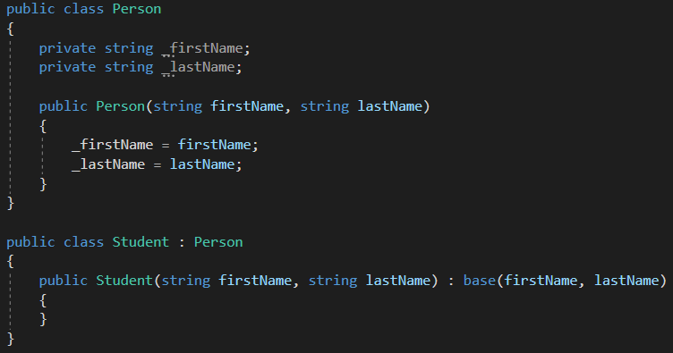
Class inheritance

Slide 14
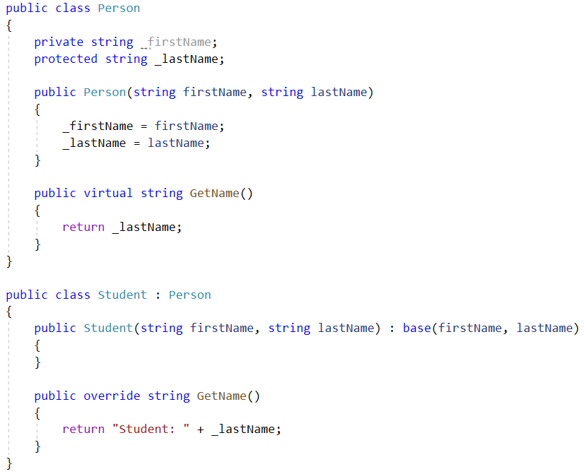
Class inheritance

Slide 15
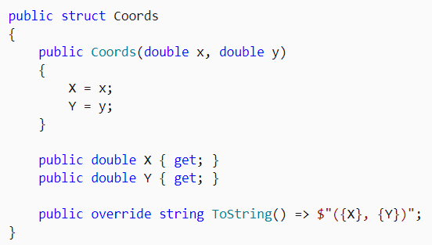
Struct
A structure type (or struct type) is a value type that can encapsulate data and related functionality. You use the struct keyword to define a structure type.
Notes:
readonly struct
You can't declare a parameterless constructor. Every structure type already provides an implicit parameterless constructor that produces the default value of the type.
You can't initialize an instance field or property at its declaration. However, you can initialize a static or const field or a static property at its declaration.
A constructor of a structure type must initialize all instance fields of the type.
A structure type can't inherit from other class or structure type and it can't be the base of a class. However, a structure type can implement interfaces.
You can't declare a finalizer within a structure type.

Slide 16
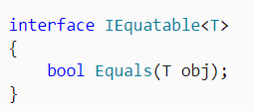
Interface
An interface contains definitions for a group of related functionalities that a non-abstract class or a struct must implement.

Slide 17
Interface
An interface is typically like an abstract base class with only abstract members.
Any class or struct that implements the interface must implement all its members.
An interface can't be instantiated directly. Its members are implemented by any class or struct that implements the interface.
A class or struct can implement multiple interfaces. A class can inherit a base class and also implement one or more interfaces.

Slide 18
Built-in interfaces
IEquatable<T>
IComparable<T>
IDisposable

Slide 19
Access modifers
public: The type or member can be accessed by any other code in the same assembly or another assembly that references it.
private: The type or member can be accessed only by code in the same class or struct.
protected: The type or member can be accessed only by code in the same class, or in a class that is derived from that class.
internal: The type or member can be accessed by any code in the same assembly, but not from another assembly.
protected internal: The type or member can be accessed by any code in the assembly in which it's declared, or from within a derived class in another assembly.
private protected: The type or member can be accessed only within its declaring assembly, by code in the same class or in a type that is derived from that class.

Slide 20
Properties
Properties are first class citizens in C#. The language defines syntax that enables developers to write code that accurately expresses their design intent.
The syntax for properties is a natural extension to fields.

Slide 21
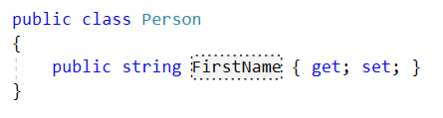

Properties

Slide 22
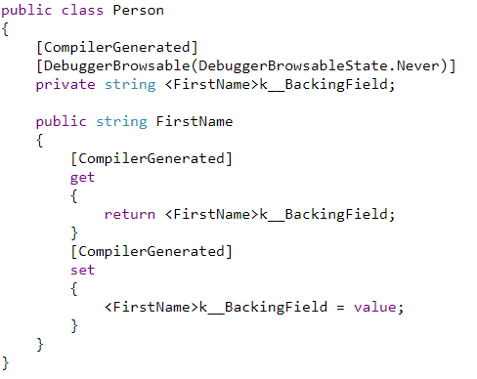
Properties

Slide 23
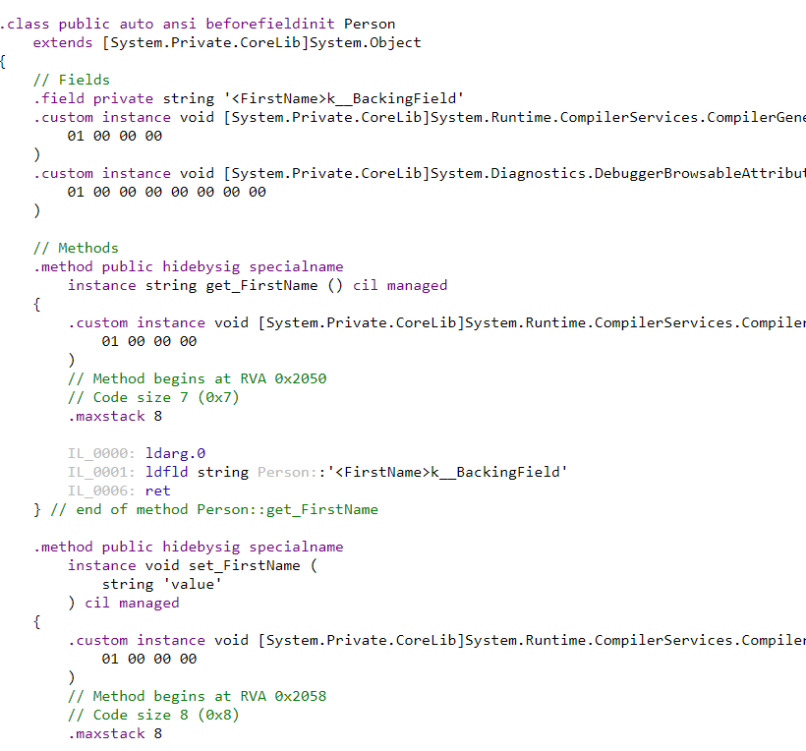
C# - properties

Slide 24
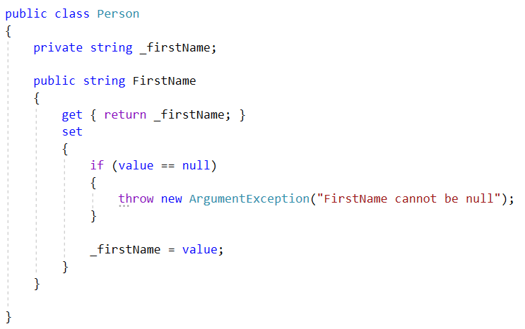
Full property

Slide 25
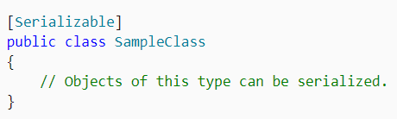
Attributes
Attributes provide a powerful method of associating metadata, or declarative information, with code (assemblies, types, methods, properties, and so forth).

Slide 26
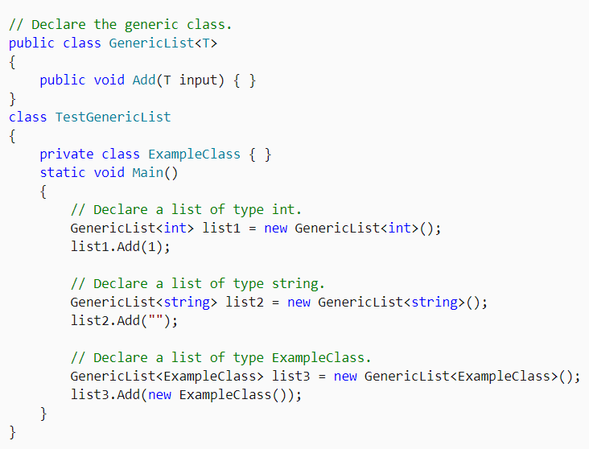
Generics

Slide 27
Generics
Use generic types to maximize code reuse, type safety, and performance.
The most common use of generics is to create collection classes.
The .NET class library contains several generic collection classes in the System.Collections.Generic namespace. These should be used whenever possible instead of classes such as ArrayList in the System.Collections namespace.
You can create your own generic interfaces, classes, methods, events, and delegates.
Generic classes may be constrained to enable access to methods on particular data types.
Information on the types that are used in a generic data type may be obtained at run-time by using reflection.

Slide 28
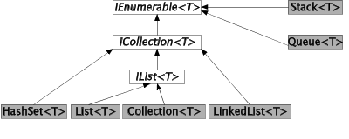
Collections

Slide 29
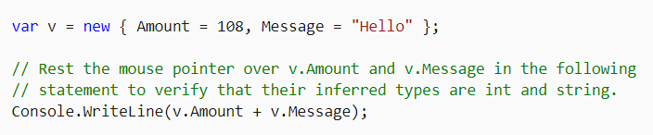
Anonymous types
Anonymous types provide a convenient way to encapsulate a set of read-only properties into a single object without having to explicitly define a type first.

Slide 30
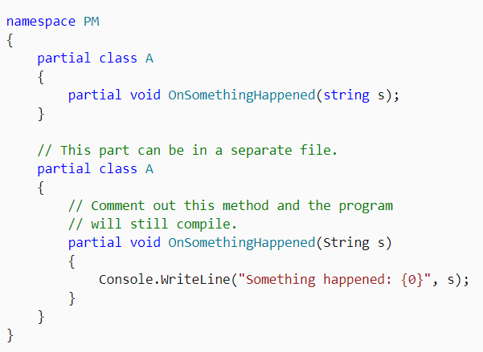
Partial types
A partial method has its signature defined in one part of a partial type, and its implementation defined in another part of the type.

Slide 31
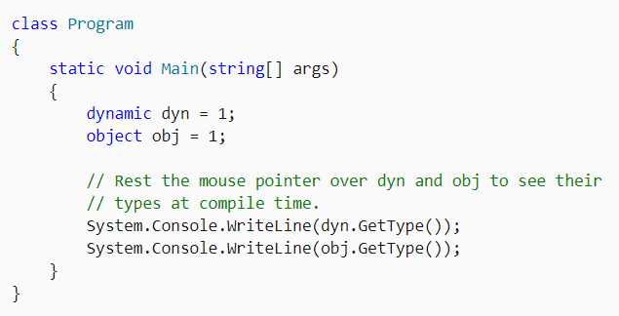
The dynamic type
The dynamic type indicates that use of the variable and references to its members bypass compile-time type checking.

Slide 32
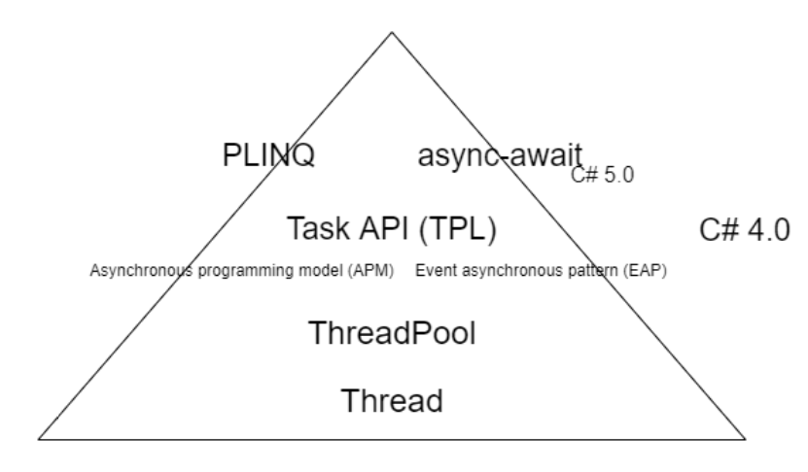
Parallel programming /Async programming

Slide 33
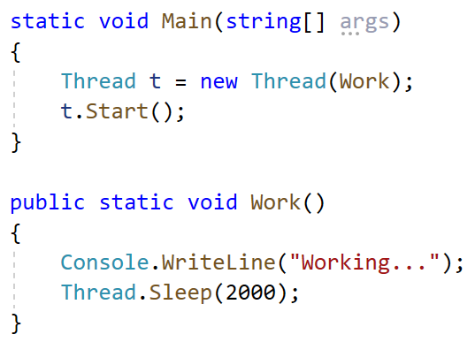
Thread

Slide 34
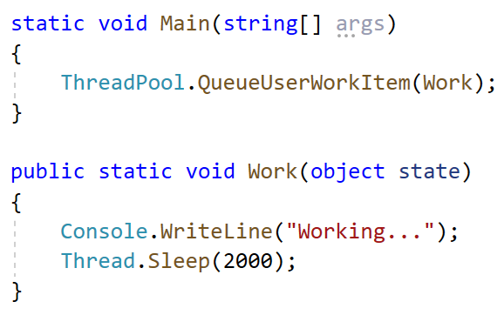
ThreadPool

Slide 35
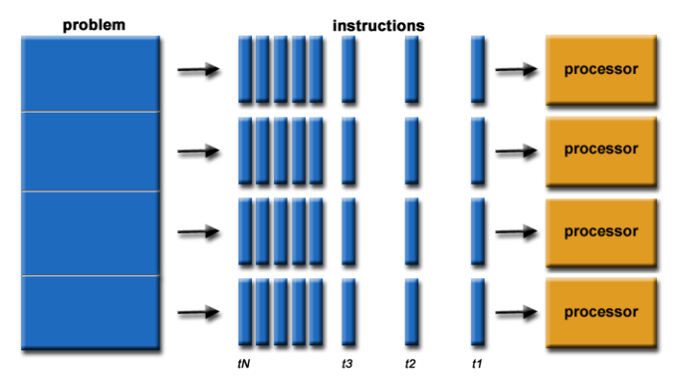
Parallel programming /Async programming

Slide 36
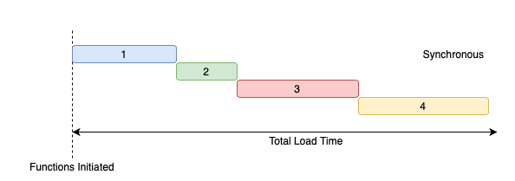
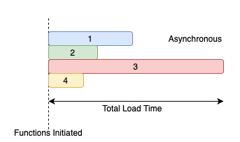
Parallel programming /Async programming

Slide 37
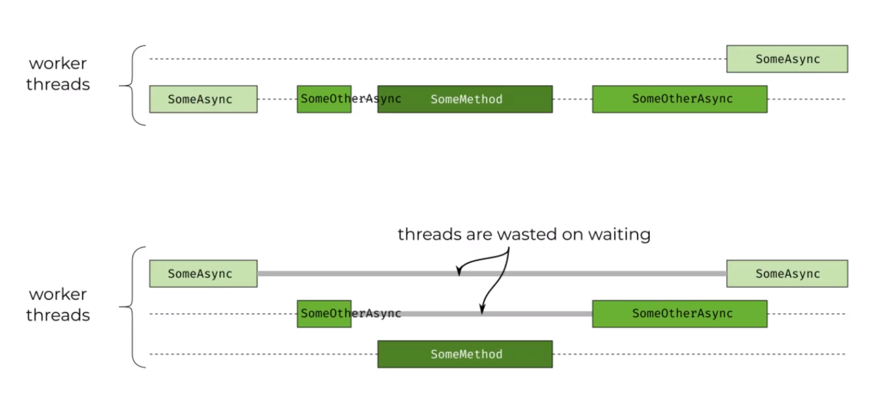
Parallel programming /Async programming

Slide 38
Asynchronous members
If you have any I/O-bound needs (such as requesting data from a network, accessing a database, or reading and writing to a file system), you'll want to utilize asynchronous programming.
Utilizes some of the concept which existed before in C#

Slide 39
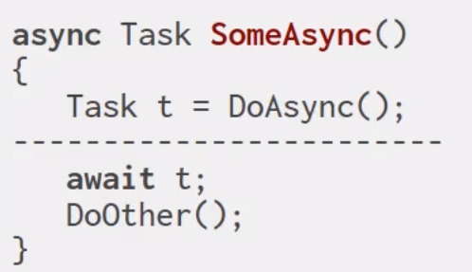
Async programming

Slide 40
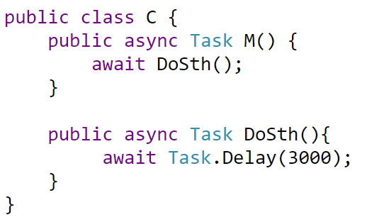
Async programming

Slide 41
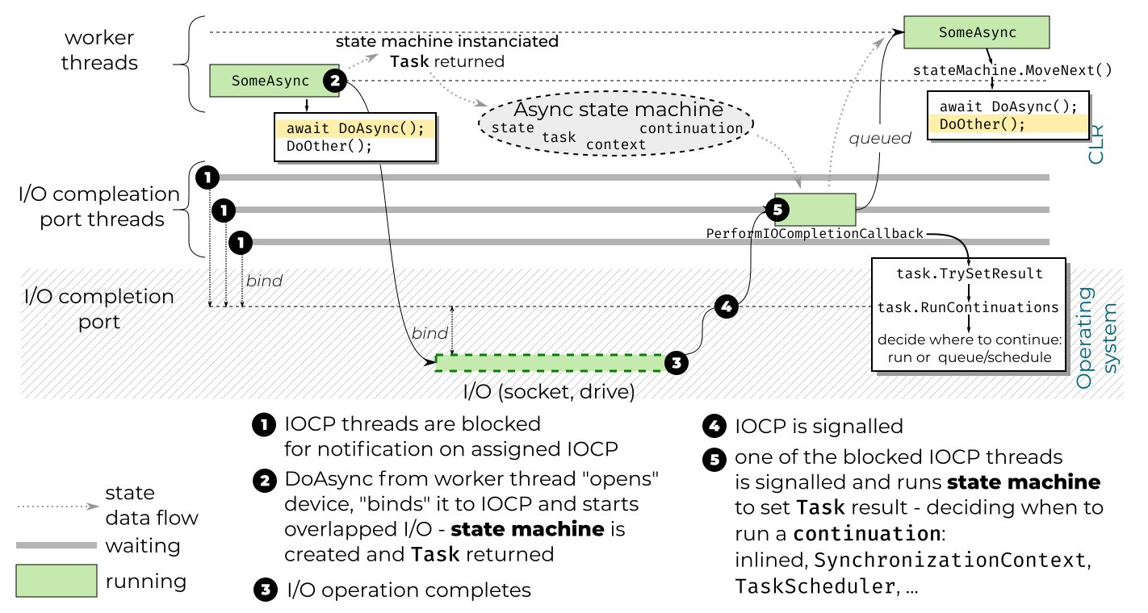
Async programming

Slide 42
C# - parallel and async programming
https://docs.microsoft.com/en-us/dotnet/standard/parallel-processing-and-concurrency
http://blog.kokosa.net/
https://tooslowexception.com/

Slide 43
C# - guidelines and conventions
https://docs.microsoft.com/en-us/dotnet/csharp/programming-guide/inside-a-program/coding-conventions
https://github.com/ktaranov/naming-convention/blob/master/C%23%20Coding%20Standards%20and%20Naming%20Conventions.md

Slide 44
C# - additional resources about the language
https://docs.microsoft.com/en-us/dotnet/csharp/whats-new/csharp-version-history
https://docs.microsoft.com/en-us/dotnet/csharp/tour-of-csharp/
https://www.tutorialspoint.com/csharp/index.htm
http://people.cs.aau.dk/~normark/oop-csharp/html/notes/collections_themes-list-sect.html
http://blog.kokosa.net/author/konrad-kokosa

Slide 45
How to write „good” software?
Different subproblems:
Logging/Monitoring
Maintainability
User requirements
Performance
Readability
Testability

Slide 46
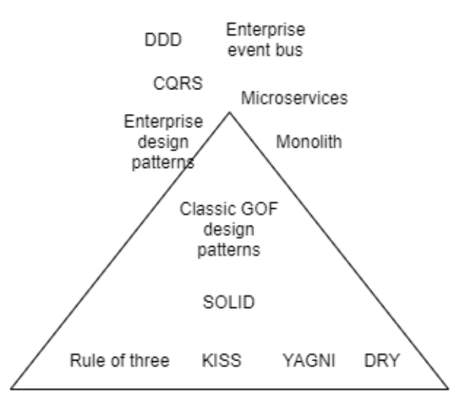
Different guidelines

Slide 47
SOLID
In object-oriented computer programming, SOLID is a mnemonic acronym for five design principles intended to make software designs more understandable, flexible, and maintainable.
The principles are a subset of many principles promoted by American software engineer and instructor Robert C. Martin,first introduced in his 2000 paper Design Principles and Design Patterns.
https://sites.google.com/site/unclebobconsultingllc/getting-a-solid-start
http://cleancoder.com/products

Slide 48
SOLID
Single-responsibility principle
Open–closed principle
Liskov substitution principle
Interface segregation principle
Dependency inversion principle

Slide 49
Single responsibility (SRP)
Principle that states that every class in a program should have responsibility over a single part of that program's functionality, which it should encapsulate. We can extend this to methods.
„A class should have only one reason to change”

Slide 50
Single responsibility (SRP)- example

Slide 51
Open–closed principle
„software entities (classes, modules, functions, etc.) should be open for extension, but closed for modification”

Slide 52
Open–closed principle - example

Slide 53
Liskov substitution principle
„if S is a subtype of T, then objects of type T may be replaced with objects of type S (i.e., an object of type T may be substituted with any object of a subtype S) without altering any of the desirable properties of the program”

Slide 54
Liskov substitution principle - example

Slide 55
Interface segregation principle (ISP)
„no client should be forced to depend on methods it does not use”
„ISP splits interfaces that are very large into smaller and more specific ones so that clients will only have to know about the methods that are of interest to them.”

Slide 56
Interface segregation principle (ISP) - example

Slide 57
Dependency inversion principle
form of loosely coupling software modules
strong cohesion – low coupling
High-level modules should not depend on low-level modules. Both should depend on abstractions (e.g., interfaces).
Abstractions should not depend on details. Details (concrete implementations) should depend on abstractions.

Slide 58
Dependency inversion principle - example

Slide 59

Design patterns (GoF)
Set of common solutions for frequently ocurring problems in object-oriented software design
Grouped into 4 categories:
Creational design patterns
Structural design patterns
Behavior design patterns

Slide 60
Design patterns/Refactoring - materials
https://sourcemaking.com/design_patterns
https://refactoring.guru/refactoring

Slide 61
Code refactoring - example

Slide 62
Additional materials
https://roadmap.sh/

